Slide 1






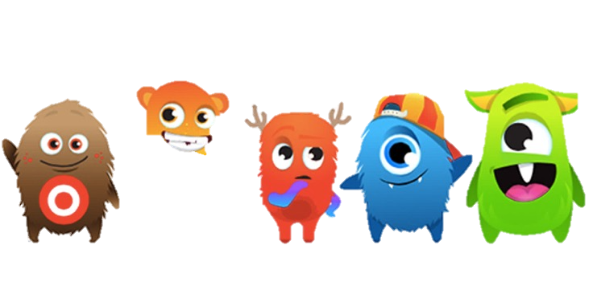
Communication

Slide 2


D6 Communicator
All information about the school
Calendar events
School newsletter/Kgotlella every week - Hard copy or electronic

Slide 3
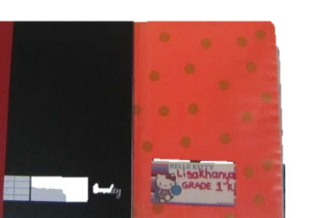
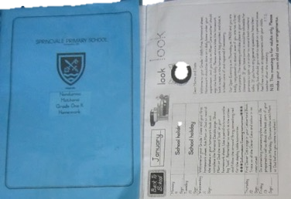
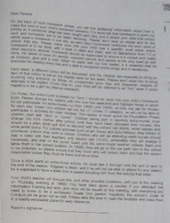
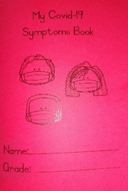
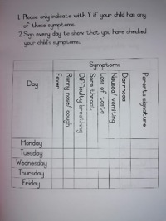
Grade One Communication
Weekly Homework Sheet
Letter on back of Homework sheet
Communication books
Class Dojo
Microsoft TEAMS
Symptoms Book

