Slide 1
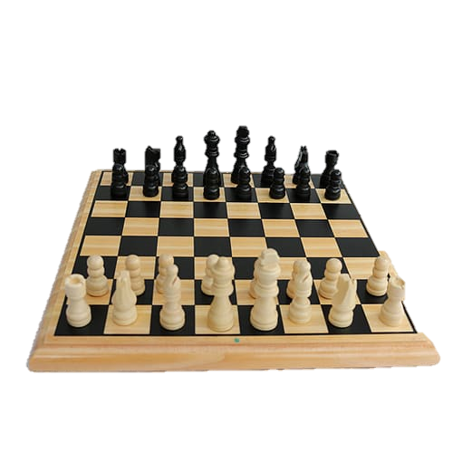

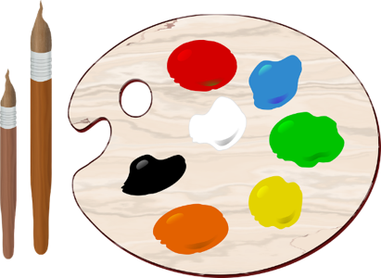

Extra Murals

Slide 2




Extra Murals
Extra murals might work a little differently this year. We will provide the information as soon as we know more.
Please take note of the important points regarding the extra murals.

Slide 3

Extra Murals
The children will receive an extra mural timetable each term. Some extra murals differ from term to term.
See example of the timetable and form that needs to be filled in each term. These will be found in the homework book.
Extra murals run from 2pm to 3pm Monday to Thursday.
Children will be able to choose 1 extra mural per day. We encourage the children to choose at least 2 or 3 for the week. Extra murals are not compulsory.
Children must attend the extra murals they have chosen until the end of the term.

Slide 4
Extra Murals
Private extra murals will be offered at an extra cost. More information to follow.
Some of the extra murals are not for the Foundation phase. Please see the age groups in brackets next to each extra mural.
Children will need to change into their Phys ed clothes for any outdoor extra murals like ball games, soccer, cricket, etc. (Packed in a backpack)
Children may not come to school dressed in Phys ed clothes unless it is their Phys ed day. ( Class teacher will inform you)
Please send extra lunch and a water bottle if your child is staying for extra murals.

Slide 5
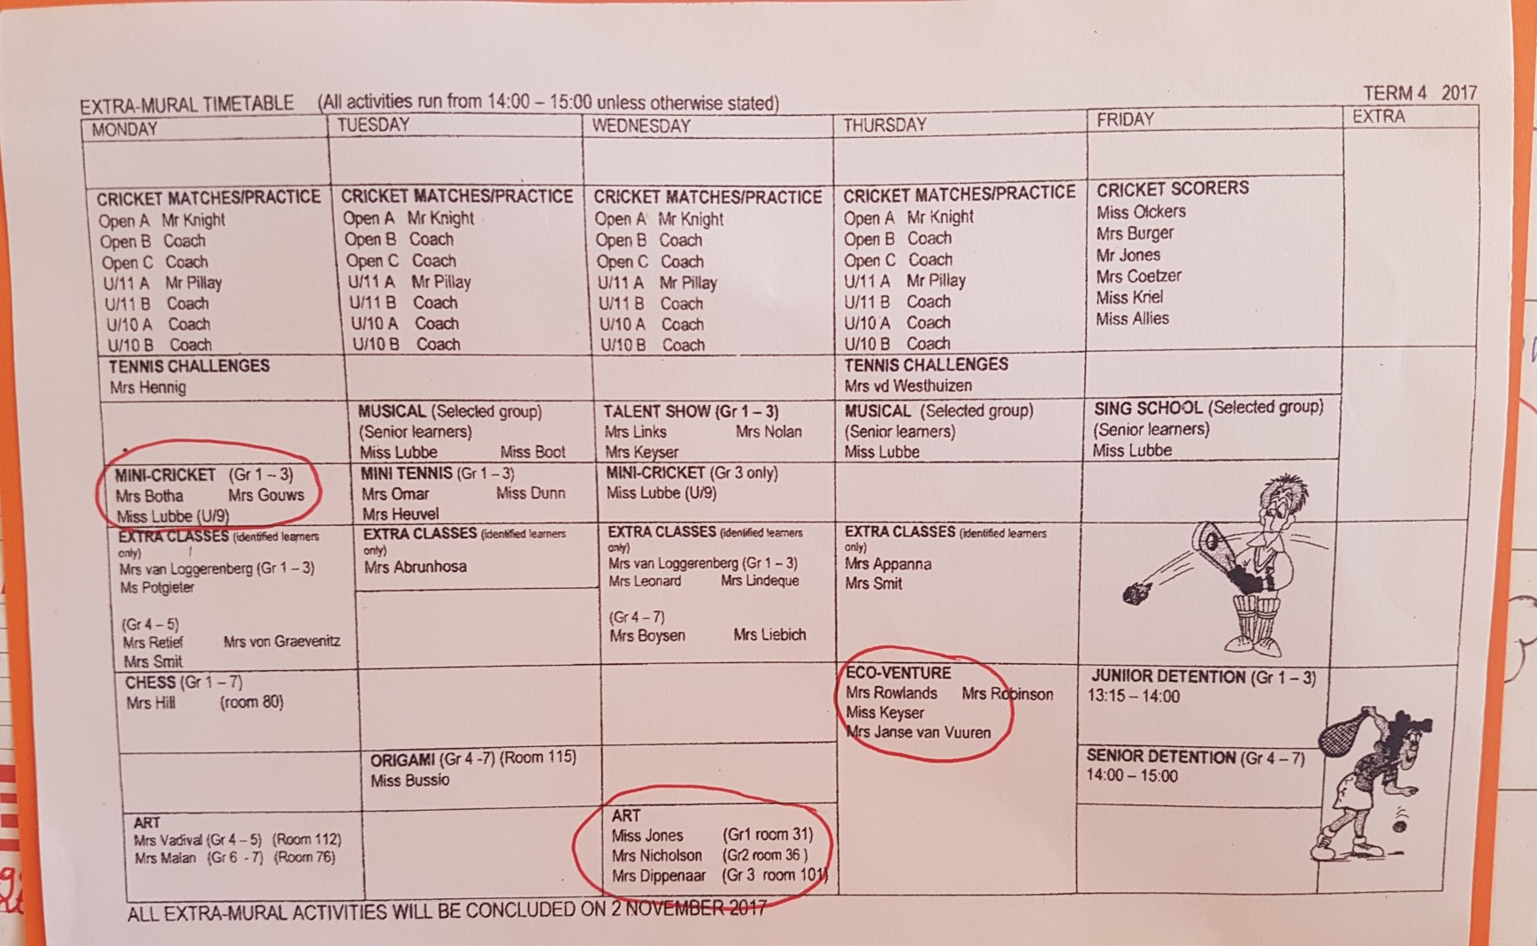

Slide 6
