Slide 1
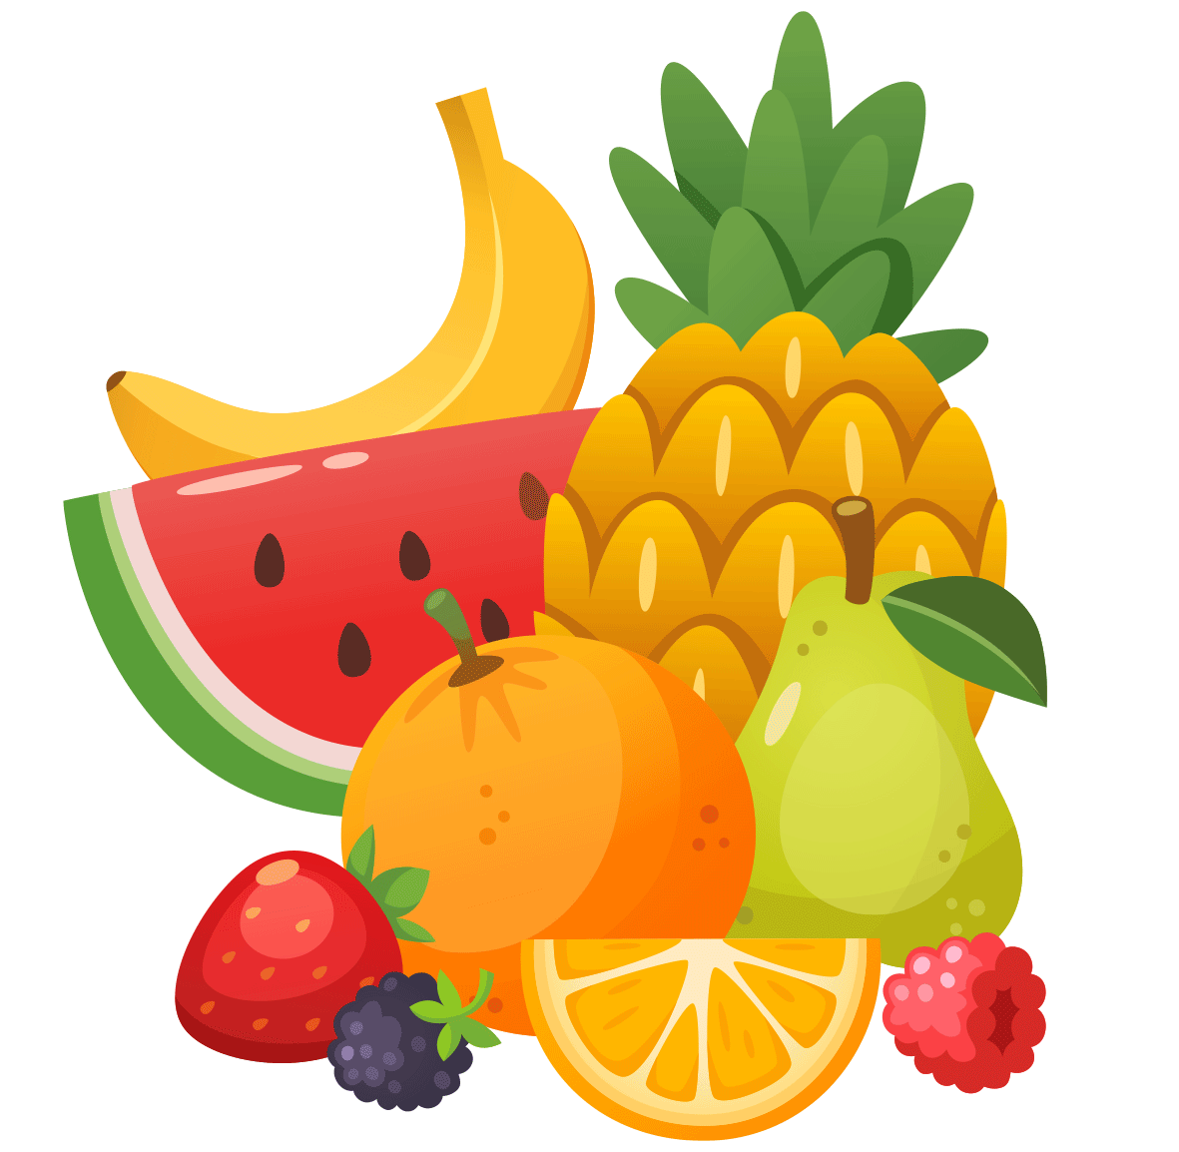
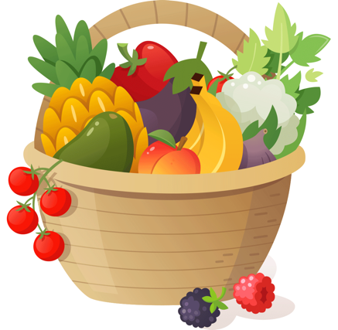
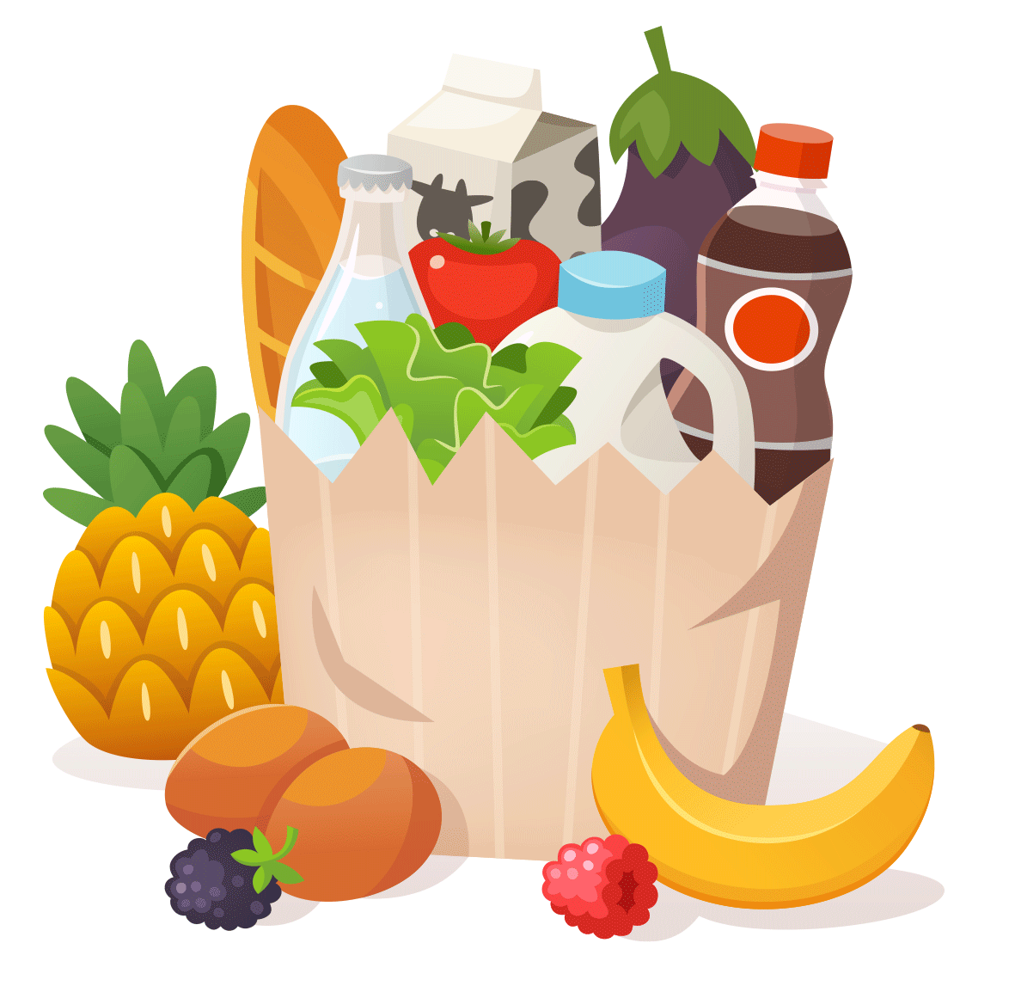
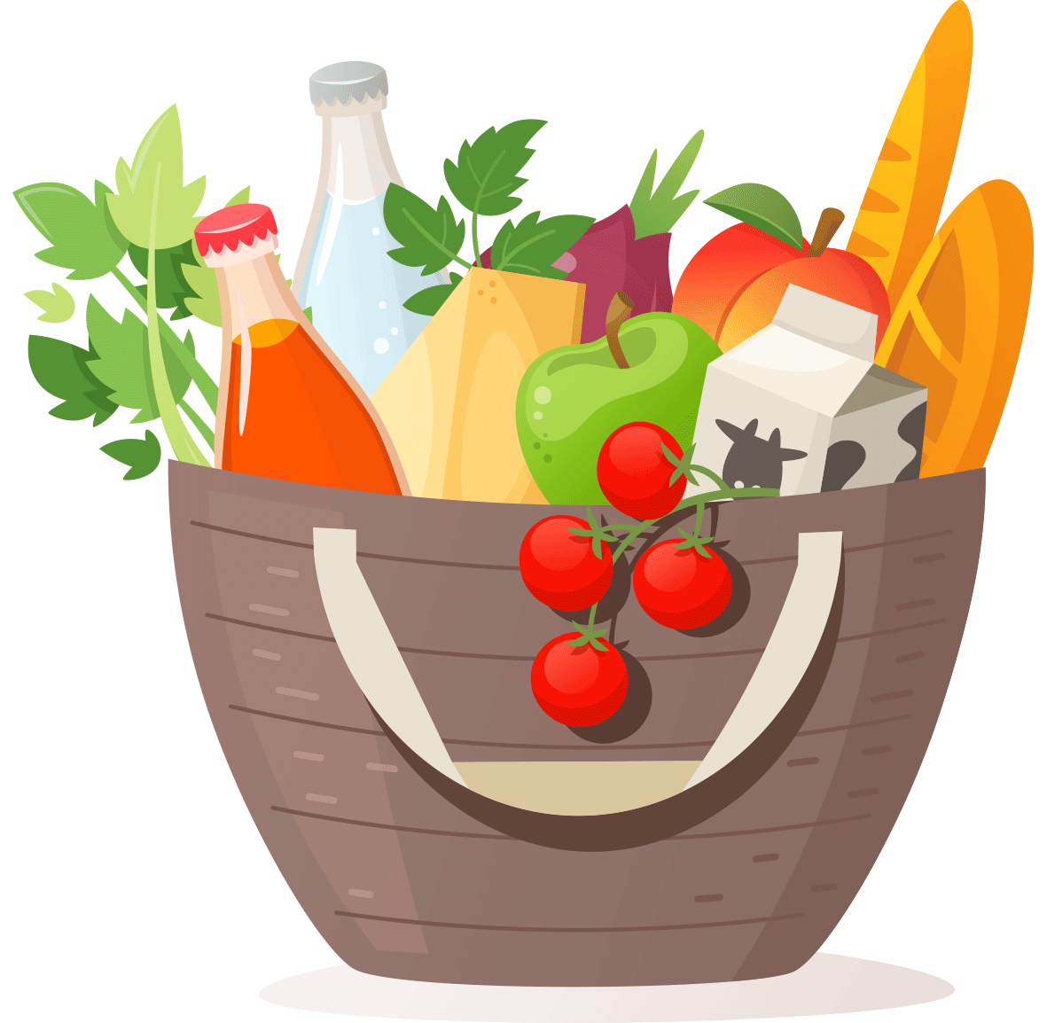
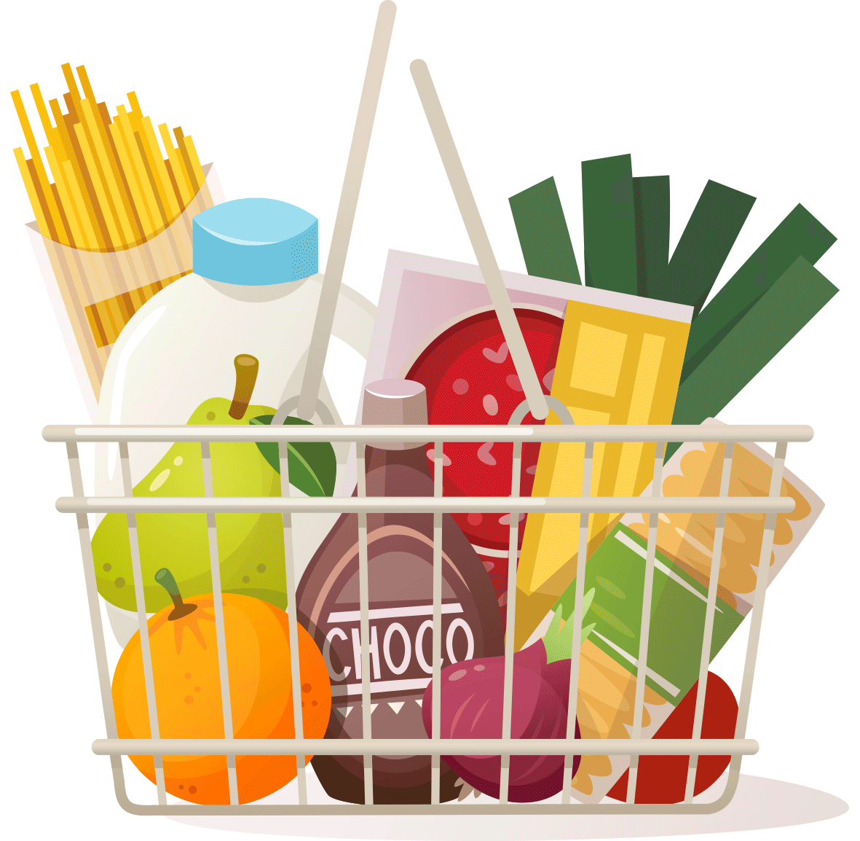

LUNCHES
We have put together some rules regarding the food that your child could eat during the school-day, and I’ll ask you to think of it less as a set of rules and more like a set of guidelines that you have to follow.
To eat or not to eat…

Slide 2
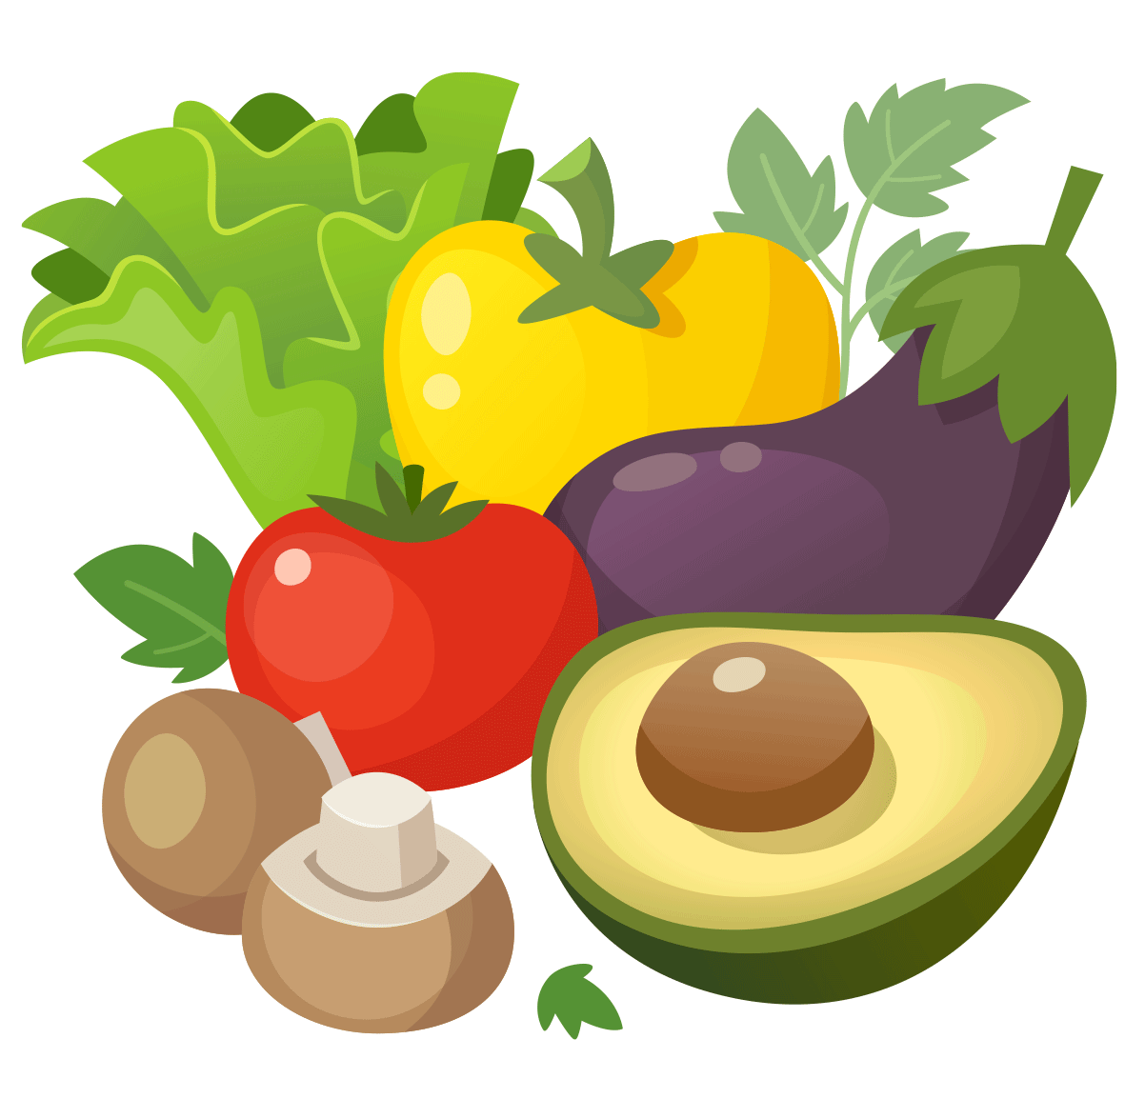
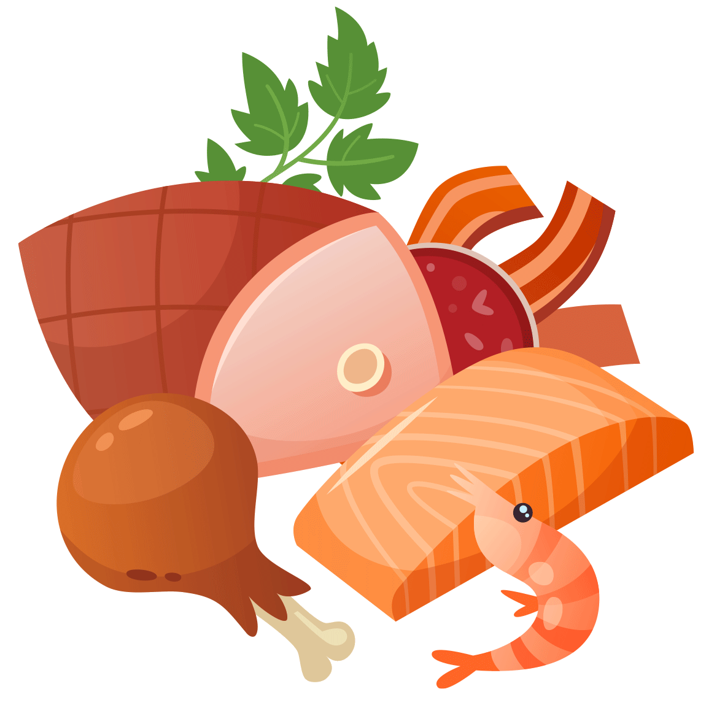
Best of the Best:
GREAT FOOD OPTIONS:
These are the best options that ensure a healthy child and a healthy mind. We have the usual sandwich with lunch-meats, salad or any protein. Fruit and cut up vegetables are a good snack.

Slide 3

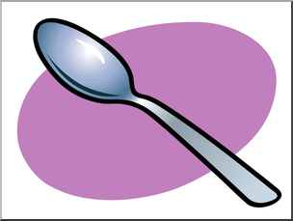


Best of the Best:
Yoghurt:
Yoghurts are also very nutritious, however, please give your child a plastic spoon with the yoghurt tub. There is a sense of helplessness that I feel every time a child tells me that they don’t have a spoon to eat their yoghurt with. What’s the big deal? – I urge you to try to eat a tub of yoghurt with a waxy.
Please send a spoon with yoghurt…

Slide 4

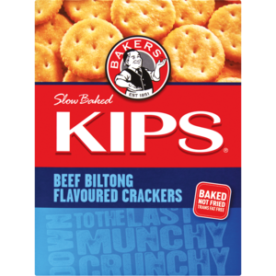
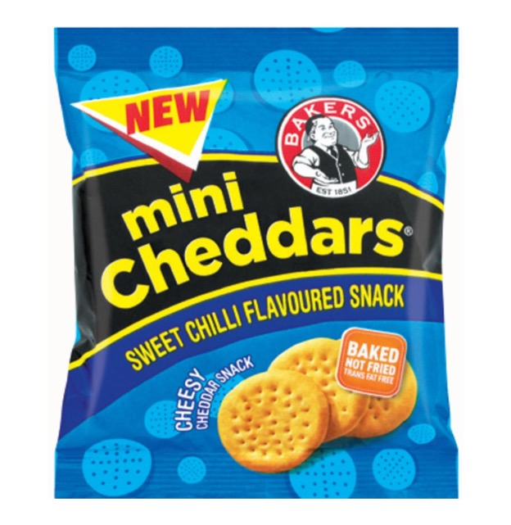
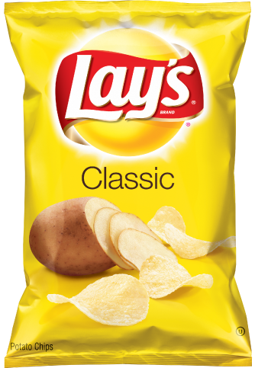
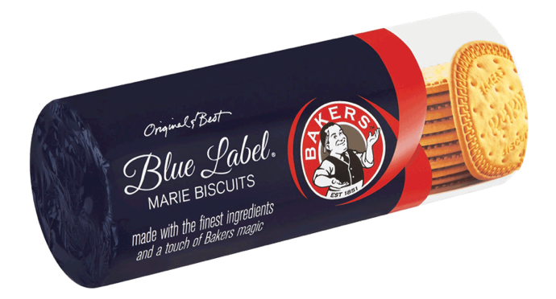
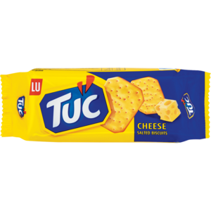
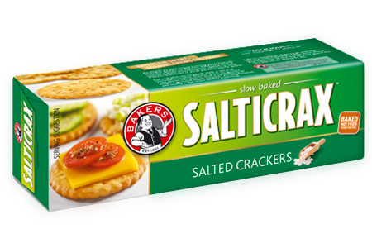
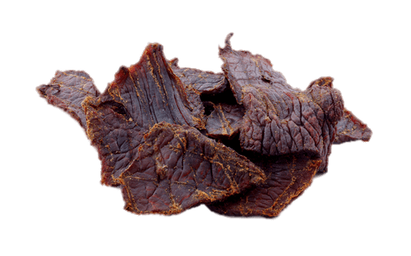
As Good As It Gets
Now we do allow some treats…
Good treats to send are the savoury/salty options like crisps and crackers.
We will allow dry biscuits like marie or tennis biscuits. Biscuits without icing.

Slide 5
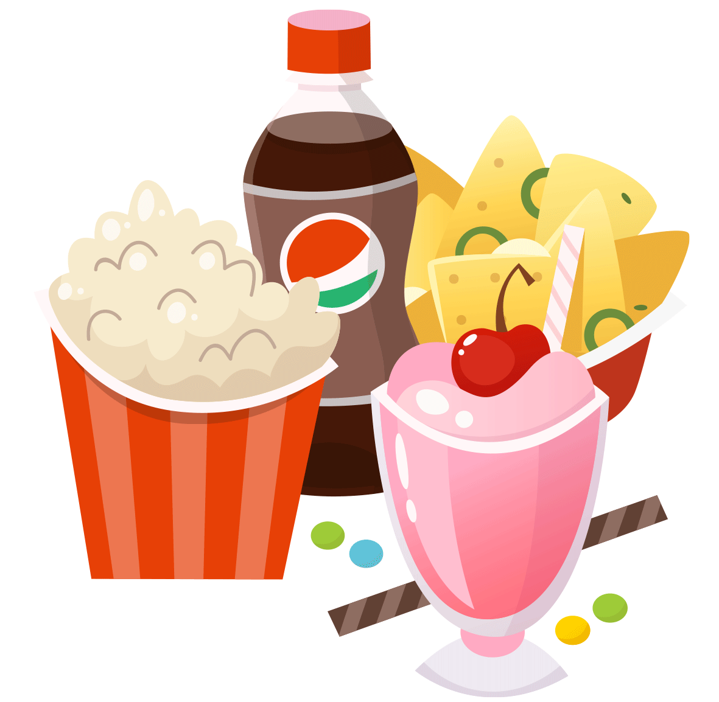
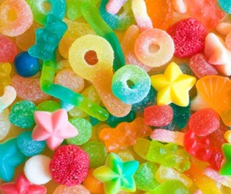
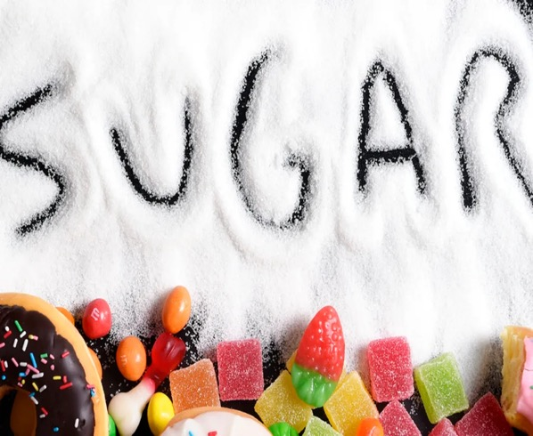
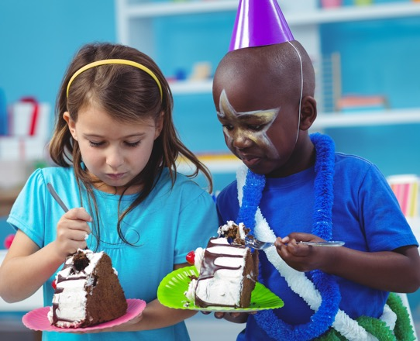
Sweet Liberty
So… what will we not allow?:
SUGAR! Sugar is unfortunately banned.
Why? The jury is still out on whether sugar actually makes a child hyperactive or not. While there has not been an actual link pin-pointing sugar as the culprit to making your child bounce off the walls, some professionals believe that rather than it being the sugar that makes your child hyper, it is the excitement of the sweets, at a party, with friends, the colourful playful bag of fun that makes the child hyperactive and not the sugar itself. We therefore have a strict policy against any form of excitement in your child’s lunchbox.

Slide 6
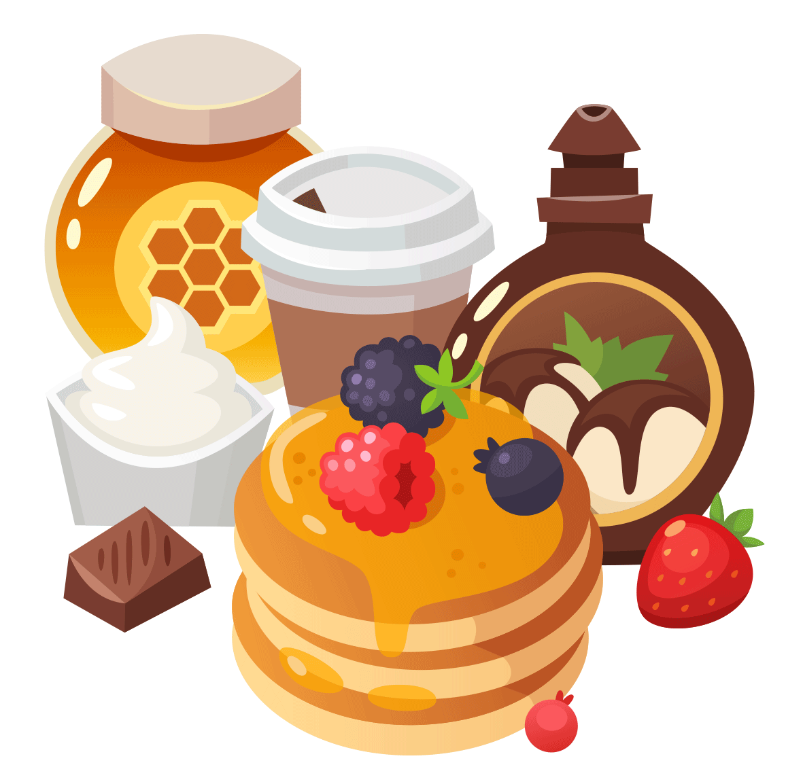

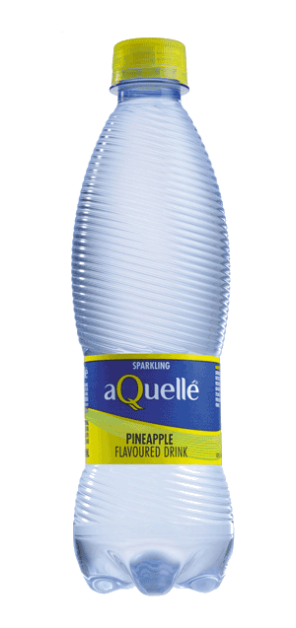
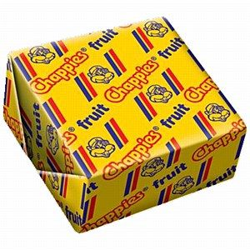
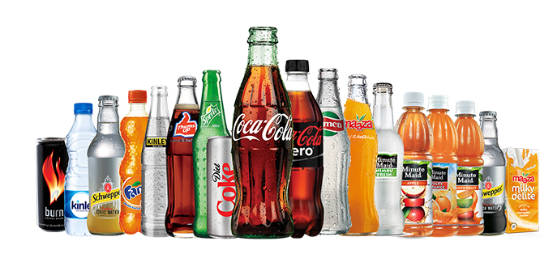
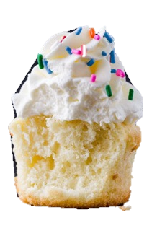
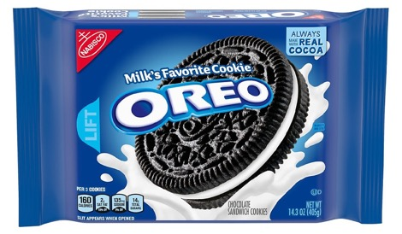
The Usual Suspects
So, no sugary-creamy biscuits (oreos), twinkies, basically nothing fun. No sweets at all. No GUM anywhere! Ever! Remember going to school and accidentally putting your hand under the table and feeling little mountains of pre-chewed gum underneath! – this school really tries to eliminate that unpleasantness completely. No sodas, no iced teas (which have sometimes more sugar than the sodas), no juices whatsoever.
No flavoured waters, please, it’s simply colourless cooldrink.

Slide 7
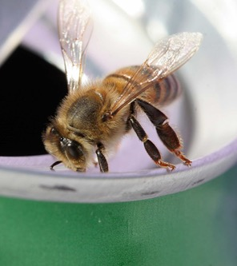
A Spoonful of Sugar…
Why do we limit the learner’s sugar intake?
Sugar is an “empty calorie food”. It provides calories but has no protective nutrients.
Sugar is associated with obesity and tooth decay
Too much sugar affects the memory negatively
The bees love it…

Slide 8

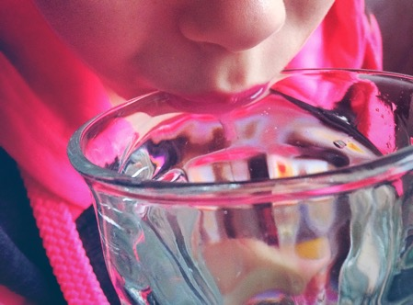
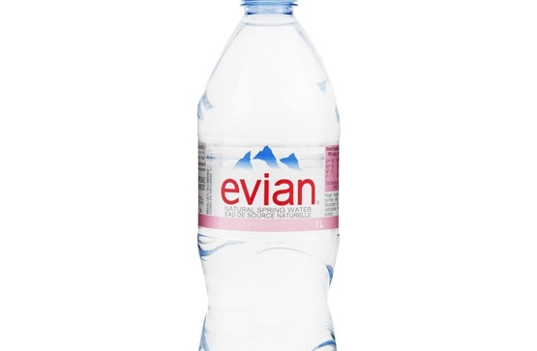
Water… Water… Everywhere!
What can your child drink?
You have a whole variety of different waters to choose from. There is tap water, lovingly poured into a colourful water-bottle. There is actual bottled water like Valpre or BonAqua, and if you really want to spoil your child because they deserve it, then splash out on some Evian.

Slide 9
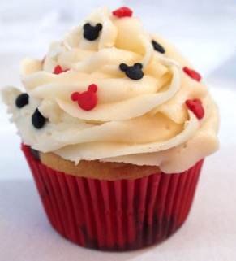

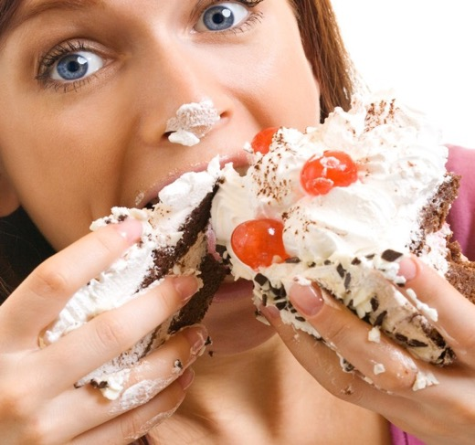
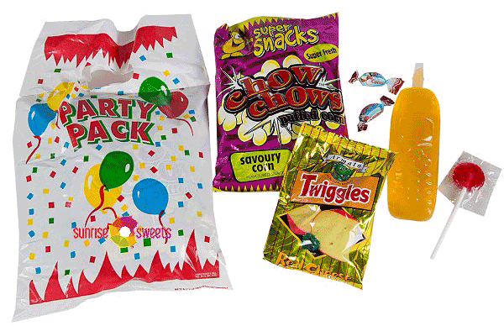
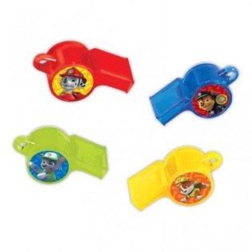
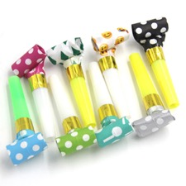
It’s My Party…
No sugar! What then about birthdays?
THE GOOD… | THE BAD… | AND THE UGLY

Slide 10


Tuck Everlasting
Halaal
Hotdogs
Pizzas
Burgers
Toasted Sandwich
and…
Water
The food gets delivered to your child. You will need to order via the Karri App.

